Slide 1

SAP SE CS&D APJ Early Talent Program Developing a Solution Proposal
Harsh Mahawar
SAP SE CS&D Skill Management
Add partner logo and alt text

Slide 2

Solution Proposal Presentation Requirements
Customer Background (1 minute)
Current Challenges (1 minute)
As-Is Architecture and Pain Points (1 minute)
Project Skynet Objectives (1 minute)
Proposed Target Architecture (1 minute)
Software Recommendations (6 minutes)
Use Cases (4 minutes)
Summary (1 minute)

Slide 3
Software Recommendations
You have a total of 12 objectives, and you will scope solutions for these requirements:
Increase business agility and time to market for CX B2C commerce processes by replacing existing in-house eCommerce application with an easy-to-use, flexible and scalable eCommerce platform
Gain a strategic 360 customer insights through customer profiling. It is critical for Lextel to understand where, when, and how, customers were using their phones. This capability is a key competitive advantage in understanding, anticipating, and delivering on customer needs
Create customer segments and run targeted cross selling campaigns powered by predictive modeling to increase sales and margins
Identifying potential churners and offer promotions to instill customer loyalty
Improve customer satisfaction by providing a modern field service process to provide a quick and efficient response to customer requests (IE Dispatching a technician with the relevant information on the field)
Build trusted relationships with Customers by providing data privacy, consent and regulatory compliance
Leverage intelligent technologies to improve operational efficiencies and automate business processes
Modernize Data Warehouse, Analytics and Data Visualization Capabilities to improve customer insight
Launch a Customer Data Quality initiative to ensure all dimensions (Completeness, Timeliness, Validity, Consistency and Integrity) are scored at 100% within 2 years
Improve the current Master Data Management Solution to enable a single version of the truth for all master data over the next 3 years
Must be able to access, orchestrate, combine structured and unstructured data from various sources and make them available to the business user for self-service access and analysis
Seamless out-of-the-box integration for SAP SE On-Premise and Cloud solutions
For your presentation, you only need to build detailed slides for 2 functional, and 2 BTP requirements (for a team 5, pick 5 requirements)
The slides should describe the software solution, its key capabilities and how it can address the business requirement. DO NOT SIMPLY COPY AND PASTE SAP SE MARKETING SLIDES. Please use plain English and write in a manner that is clear, complete and yet concise.
For 2 of your recommendations, please draw out a detailed use case diagram and include a Persona

Slide 4
Fill out this Template for your Solutioning
Requirement | Current Solution(s) | Pain Points | Proposed Solution | Rationale
Increase business agility and time to market for CX B2C commerce processes by replacing existing in-house eCommerce application with an easy-to-use, flexible and scalable eCommerce platform | Webshop
Gain a strategic 360 customer insights through customer profiling. It is critical for Lextel to understand where, when, and how, customers were using their phones. This capability is a key competitive advantage in understanding, anticipating, and delivering on customer needs | SAP CRM 7.0
Create customer segments and run targeted cross selling campaigns powered by predictive modeling to increase sales and margins | SAP CRM 7.0
Notes:
Create customer segments and run targeted cross selling campaigns powered by predictive modeling to increase sales and margins
Identifying potential churners and offer promotions to instill customer loyalty
Improve customer satisfaction by providing a modern field service process to provide a quick and efficient response to customer requests (IE Dispatching a technician with the relevant information on the field)
Build trusted relationships with Customers by providing data privacy, consent and regulatory compliance

Slide 5
Fill out this Template for your Solutioning
Requirement | Current Solution(s) | Pain Points | Proposed Solution | Rationale
Identifying potential churners and offer promotions to instill customer loyalty | SAP CRM 7.0
Improve customer satisfaction by providing a modern field service process to provide a quick and efficient response to customer requests (IE Dispatching a technician with the relevant information on the field) | SAP CRM 7.0
Build trusted relationships with Customers by providing data privacy, consent and regulatory compliance | SAP CRM 7.0

Slide 6
Fill out this Template for your Solutioning
Requirement | Current Solution(s) | Pain Points | Proposed Solution | Rationale
Leverage intelligent technologies to improve operational efficiencies and automate business processes | None
Modernize Data Warehouse, Analytics and Data Visualization Capabilities to improve customer insight | SAP BW 7.5 and SAP BusinessObjects 4.3
Launch a Customer Data Quality initiative to ensure all dimensions (Completeness, Timeliness, Validity, Consistency and Integrity) are scored at 100% within 2 years | SAP Data Services 4.2
Notes:
Leverage intelligent technologies to improve operational efficiencies and automate business processes
Modernize Data Warehouse, Analytics and Data Visualization Capabilities to improve customer insight

Slide 7
Fill out this Template for your Solutioning
Requirement | Current Solution(s) | Pain Points | Proposed Solution | Rationale
Improve the current Master Data Management Solution to enable a single version of the truth for all master data over the next 3 years | SAP Master Data Management 7.1
Must be able to access, orchestrate, combine structured and unstructured data from various sources and make them available to the business user for self-service access and analysis | SAP Data Services 4.2
Seamless out-of-the-box integration for SAP On-Premise and Cloud solutions | SAP Process Integration, Mulesoft, IBM MFT, Tibco

Slide 8
Next Steps
Start researching potential SAP SE Software solutions by using the Solution Scout (https://solutionscout.sap.com/)
Once you’ve identified potential solutions, do additional research by reviewing L1 / L2 presentation decks (dam.sap.com), reading blogs, watching youtube videos, or view SAP SE Training courses (learning.sap.com, open.sap.com) to better understand the capabilities of these solutions.
Start preparing the content of your presentation
Reach out to your local network to get support and coaching. Get their advice, but make sure you do the work because you will be the one presenting!

Slide 9
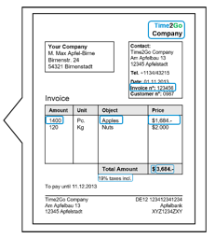
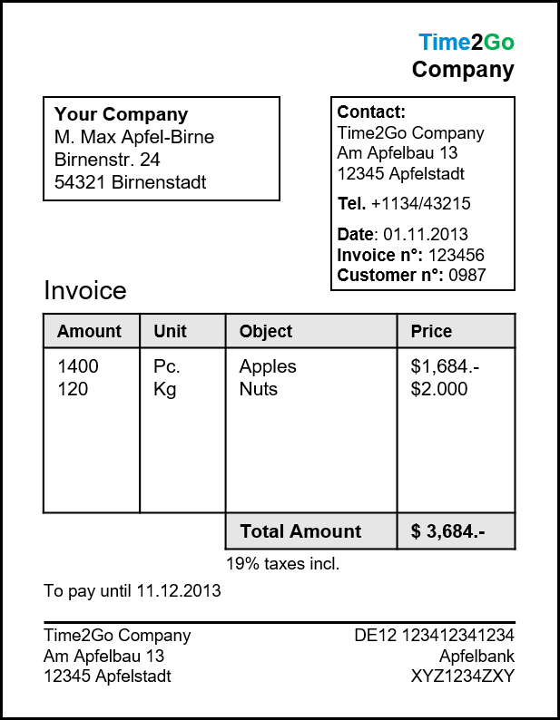




Problem: Large Volumes of Incoming business documents
Example Use Case
John, spends much time on searching and matching the right information
John, AP-Clerk
Notes:
John is an accounts payables clerk, working 8 hours shifts on processing large amounts of documents, especially Invoices in his case.
For processing these invoices, John needs to read the whole invoice, understand the context and then extract the needed information into a table. Besides this some information, in some cases a matching of information is needed, for example the company name has a customer ID, which will be matched manually.
A lot time is spend on extracting, which is not always perfectly right – errors can occur in manual extraction because of misunderstandings,

Slide 10


Solution: Automation and Document Information Extraction
Company | Time2Go Company
Supplier ID | 009753
Invoice N° | 123456
Amount | 3684.00
Currency | USD
Date | 2013-11-01
Position 1 | Amount: 1400 Unit: PC Amount: 1684.00 Description: Apples
Position 2 | Amount: 120 Unit: KG Amount: 2000.00 Description: Nuts
Enrichment happens manually
John, Can now do more value creative tasks
John, AP-Clerk

Slide 11






Solution: Automation and Document Information Extraction for Accounts Payable
Extraction
Document Information Extraction
Enrichment
Large amount of invoices
Accelerate match of invoices to POs
BUSINESS PROBLEM
SOLUTION
BENEFITS
Deal with huge number of paper-based and digital invoices
Manually extract information
Long processing time
Document Information Extraction
Extracts all relevant information automatically from the document
Enriches the extracted information with additional information
Increase efficiency and reduce errors
Enable teams to focus on strategic tasks
Reduce liabilities
Enhance supplier relation-ships
Leverage early payment discounts
SAP SOLUTIONS IN THIS USE CASE:
Document Information Extraction via CPEA
Notes:
Steps:
Unorganized large volumes of business-documents
Document Information Extraction: Extraction & Enrichment of information
Reduced manual maintenance effort & increased document processing efficiency
Business Problem
Deal with huge number of paper-based and digital invoices
Manually extract information
Long processing time
Solution:
Document Information Extraction
Extracts all relevant information automatically from the document
Enriches the extracted information with additional information based on business data, to determine the right company code and supplier ID
Benefits:
Increase efficiency and reduce errors
Enable teams to focus on strategic tasks
Reduce liabilities
Enhance supplier relation-ships
Leverage early payment discounts

Slide 12


SAP SE Build Process Automation HXM Use Case – Employment Offer Letter Creation
Example Use Case
The Challenge
The preparation of customize offer letters with multiple country specific variations requires consolidating information from several sources. It can be a time consuming and error prone manual activity in the HR department.

Slide 13











SAP SE Build Process Automation Employment Offer Letter Process Automation Solution
SAP SE Process Automation services will automate employee offer letter generation based on the input provided from the business rules maintained in the offer letter step. The configured SAP SE process automation bot run on a schedule basis defined by the user and sends out offer letters based on the rules set up
Solution
Benefits
1 minute taken to generate one package by Lucy
Candidate information in Success Factors
Bot is scheduled to check SuccessFactors every 10 minutes for candidates in Status “Request Offer Letter”
Candidates that meet the Status Criteria will trigger the Bot to execute.
At least 15x faster as compared to the as-is process
24/7 availability without human supervision
Fetches data and rules from various documents
Selects appropriate contract templates based on the candidate’s metadata and rules
Populates each contract template based on the candidate’s metadata
Sends out email notification to HR Services

